Slide 1
Superior vena cava syndrome
Sheba 21/11/17
Noa Granot

Slide 2
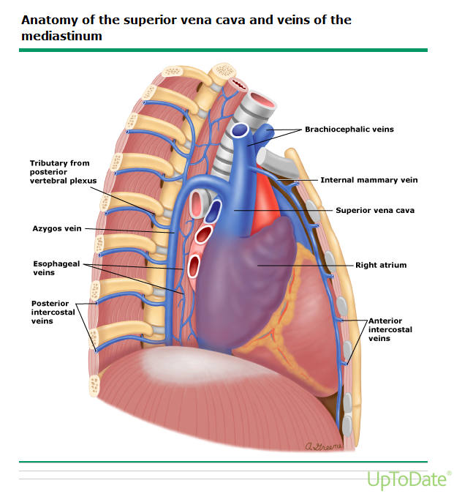
INTRODUCTION
Obstruction-
Invasion/ Blood clot
External compression
Notes:
הווריד הנבוב העליון (Vena cava superior) מנקז את ורידי הראש והזרוע (vena brachiocephalica) הימני והשמאלי, שאחראים על ניקוז הדם המחוזר בעיקר מן הראש, החזה והגפיים העליונות.
וריד מרכזי נוסף המתנקז לווריד הנבוב העליון הוא הווריד האי-זוגי (Azygos), אשר מנקז דם מכלי הדם העוטפים את עמוד השדרה והשרירים הבין-צלעיים.
הסינדרום נובע מחסימה של זרימת הדם דרך הואנה קאבה. חסימה – חיצונית או אינבזיבית ע"י פתולוגיה מסביב המערבת את ריאה ימין, בלוטות לימפה ומבנים אחרים במדיאסטינום או טרומבוס. לפעמים יכולה להיות גם פתולוגיה וגם טרומבוס.

Slide 3
PATHOPHYSIOLOGY
Obstruction SVC
Collateral veins
Dilation
Upper body venous pressure
central venous pressures
symptoms of SVC syn.
How much time until symptoms?
Symptoms:
Interstitial edema of the head and neck- causing dyspnea, stridor, cough, hoarseness, and dysphagia.
Cerebral edema- lead to cerebral ischemia, herniation, and possibly death.
Physical examination- facial edema and distension of the veins in the neck and on the chest wall. Arm edema and cyanosis are less frequent.
Notes:
כאשר יש חסימה של ה-SVC – נוצרים קולטרלים ורידיים כדי להחזיר דם ורידי לעלייה ימין. הם יכולים להיווצר מה-
Collateral veins may arise from the azygos, internal mammary, lateral thoracic, paraspinous, and esophageal venous systems
אם יש ממאירות שגדלה מהר- מפתחים תוך שבועות עד חודשים את הסימפטומים כי אין מספיק זמן לייצר קולטרלים.
לעומת זאת, נגיד בפיברוזיס מדיאסטניטיס בשל זיהום (כמו היסטפלסמוזיס)- אפשר להיות א-סימפטומי במשך שנים.
קוצר נשימה הכי שכיח. נפיחות בפנים מחמירה ברכינה קדימה או בשכיבה.

Slide 4
ETIOLOGY
1. Malignancy ( 60 to 85 %)
SVC obstruction is the presenting symptom of a previously undiagnosed tumor in up to 60% .
Non-small cell lung cancer (NSCLC) is the most common malignant cause of SVC syndrome, accounting for 50% of all cases.
Small cell lung cancer (SCLC; 25 %)
Non-Hodgkin lymphoma (NHL; 10%- Diffuse large cell and lymphoblastic lymphomas are the most common subtypes).
Less common- thymoma, primary mediastinal germ cell neoplasms, mesothelioma, and solid tumors with mediastinal lymph node metastases (eg, breast cancer)
Venous obstruction in these cases results from extrinsic compression of the SVC by either the primary tumor or enlarged mediastinal lymph nodes, or as a result of direct tumor invasion of the SVC.
Notes:
SCLC יותר מרכזי מאשר פריפרי
Fewer than 2 percent of patients presenting with NSCLC have SVC syndrome as a complication, but because of the higher incidence, NSCLC is a more frequent cause of SVC syndrome than is SCLC.

Slide 5
ETIOLOGY
Nonmalignant disorders (15-40%) –
2. Thrombosis — Most cases are related to the presence of indwelling intravascular devices.
3. Fibrosing mediastinitis and fungal infection — 50% of cases of SVC syndrome not due to malignancy.
The most common cause is an excessive host response to a prior infection with Histoplasma capsulatum.
Other infections associated- tuberculosis, actinomycosis, aspergillosis, blastomycosis.
In contrast, infection with nocardiosis can cause SVC syndrome by contiguous spread from a pulmonary, pleural, or cutaneous focus of infection.
4. Postradiation fibrosis - in patients who have received prior thoracic radiation therapy.

Slide 6
Imaging studies
The majority of patients have an abnormal chest radiograph- most common findings are mediastinal widening and pleural effusion (64% ;26%)
Duplex ultrasound is useful for excluding thrombus in the subclavian, axillary, and brachiocephalic veins.
The SVC cannot be directly imaged using ultrasound due to acoustic shadowing by the overlying ribs.
Indirect findings -dampening of the waveforms of the central upper extremity veins with loss of venous pulsatility and loss of respiratory variation.
Contrast-enhanced chest CT / MRI- most useful.

Slide 7
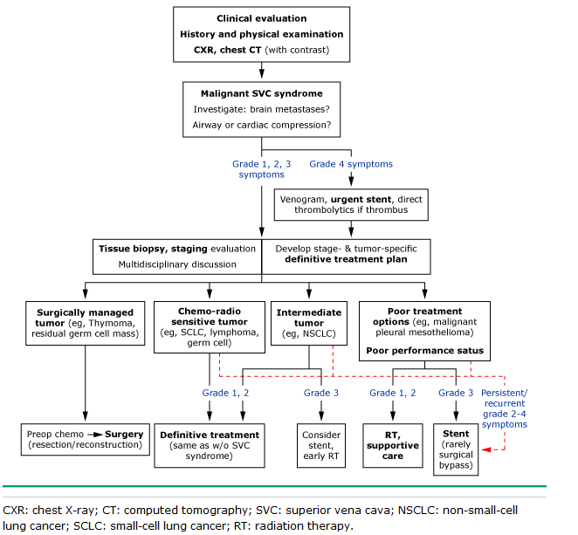
Treatment algorithm
Treatment aims:
Relieve symptoms
Treat the underlying cause of the SVC syndrome.

Slide 8
Treatment recommendations
Presentation of stridor, respiratory compromise, or depressed CNS function = emergent treatment with endovenous stenting followed by RT + short course of high-dose corticosteroids to minimize the risk of central airway obstruction.
Histologic diagnosis is required prior to initiating specific antitumor therapy.
Thrombus is present- systemic anticoagulation should be considered to limit extension of thrombus.
Surgical resection of mediastinal tumor combined with reconstruction of the SVC is rarely considered in view of its morbidity and mortality
One possible exception is malignant thymoma and thymic carcinoma, which are relatively resistant to chemotherapy and radiation. Surgical resection could be considered in selected cases as a component of a multimodality approach to treatment.

Slide 9
Any Q? Thank you!
Have a good day!

